Slide 1
TATA Data Visualization
Empowering Business with Effective Insights

Slide 2
Introduction
Hello, I am Satya Harshitha Danda, a Data Visualization Intern. In this presentation, I will guide you through our company's sales performance for the years 2010 and 2011. I am grateful for the opportunity to delve into this data and uncover valuable insights about our store's performance. I also want to thank you for your questions, as they have helped steer the analysis toward the specific insights you are seeking.

Slide 3
Thought process
I have taken all necessary steps to ensure the accuracy and correctness of this analysis.
I meticulously cleaned the data by removing any negative values in the Unit Price and Quantity columns. Additionally, I filtered the data as needed to produce precise and meaningful visualizations.

Slide 4
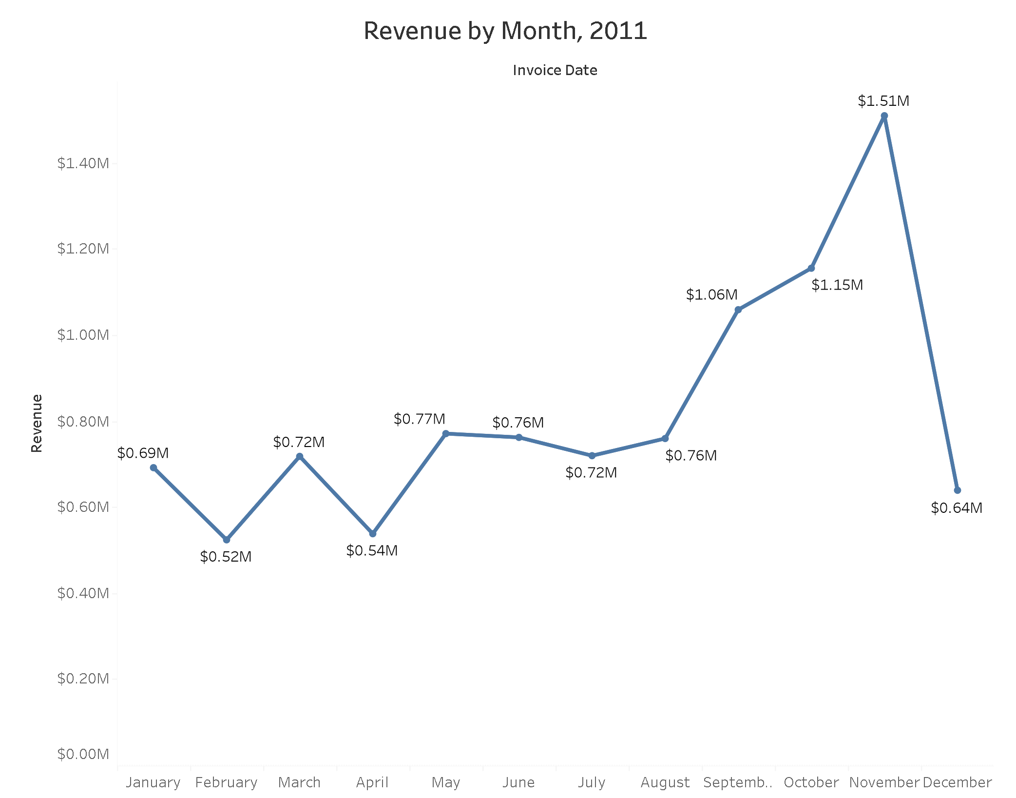
REVENUE BY Month
The first eight months showed stable monthly revenues, averaging $685,000.
Starting in September, we observed a significant increase, with revenue peaking at $1.51 million in November. From August to November, there was an average revenue increase of 21.18%.
This trend from August to December highlights the impact of seasonality on retail store sales.

Slide 5
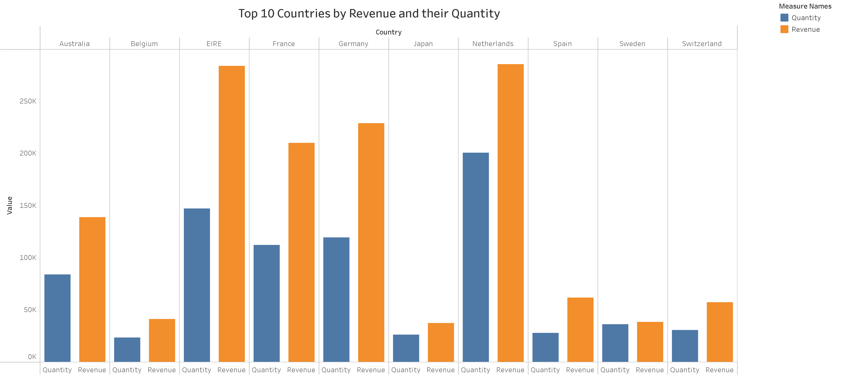
TOP 10 countries by their revenue and quantity
This chart represents the top 10 countries in terms of revenue and quantities purchased, excluding the United Kingdom.
The data indicates minimal differences between the revenue and quantity of goods sold, reflecting the high purchasing power in these countries.
These regions exhibit the highest potential for generating increased revenue, warranting a greater focus on marketing strategies.

Slide 6
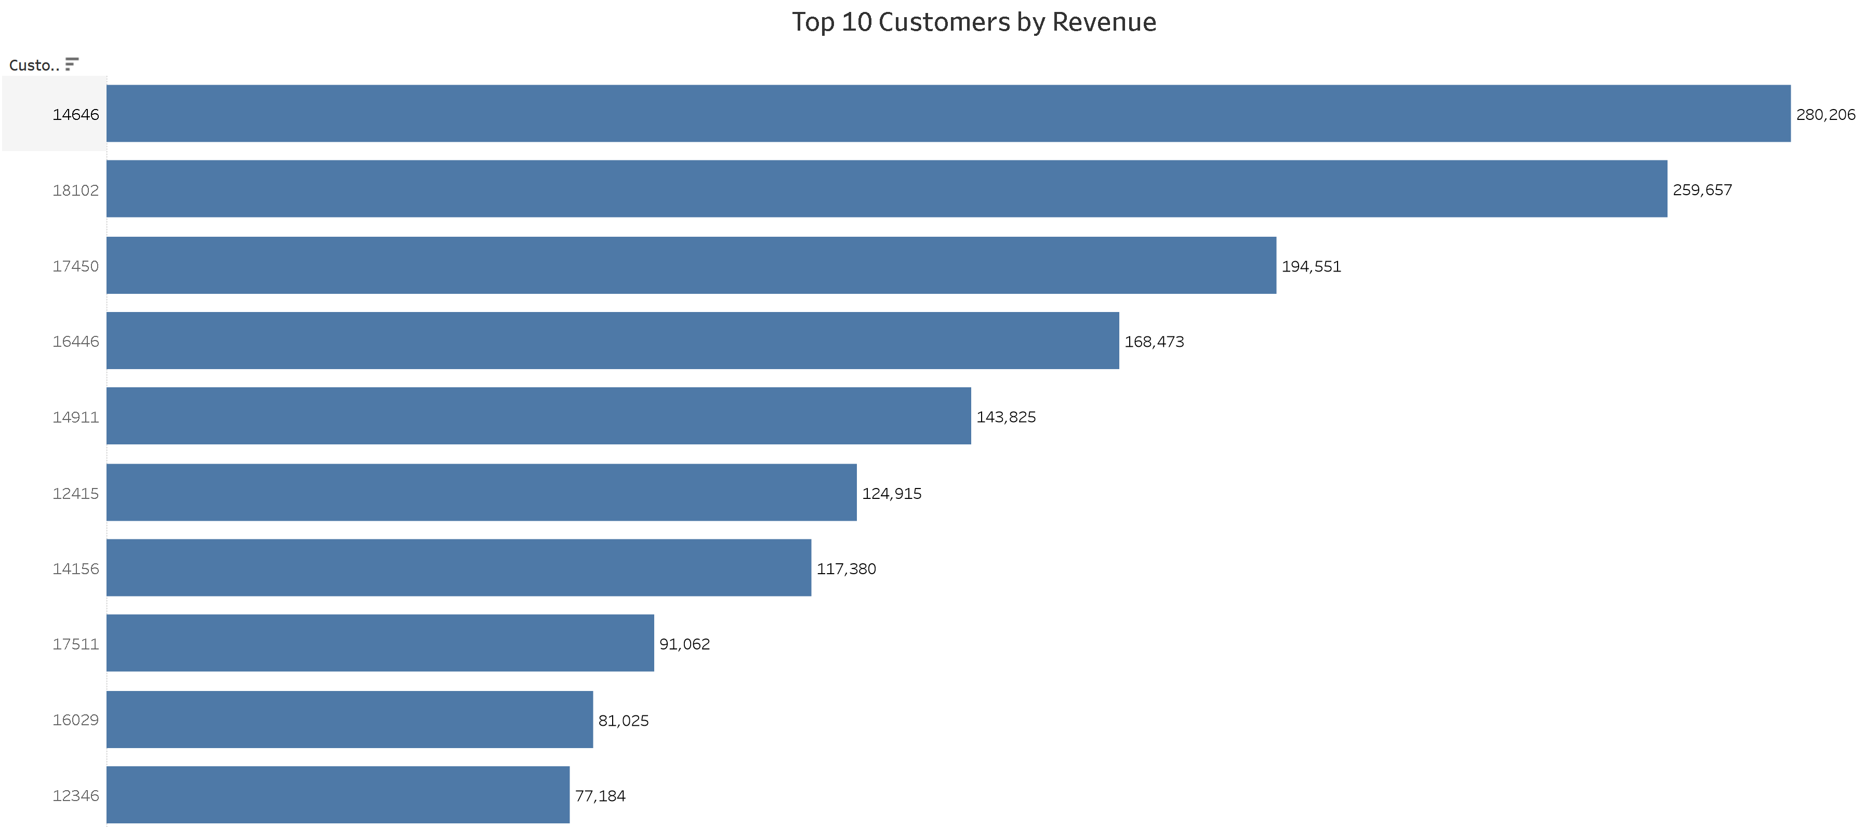
TOP 10 customers by revenue
The chart shows minimal differences in revenue generated among the top 10 customers, with an average revenue difference of 15.8%.
The company should focus on strengthening relationships with these customers to enhance loyalty and retention, which can ultimately drive more sales and revenue.

Slide 7
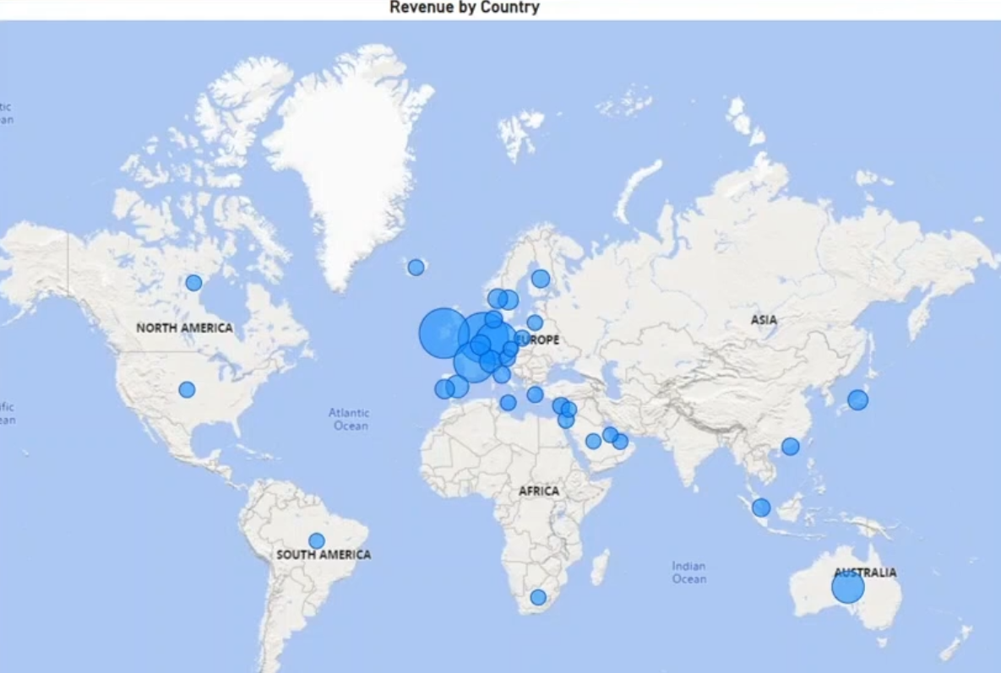
REVENUE BY Country
The map chart concludes by contrasting regions that have generated significant revenue with those that haven’t.
It also highlights that the majority of sales are concentrated in the European zone, with minimal presence in the American region.
Furthermore, aside from Russia, there is little market demand for the items in Africa or Asia.
Given these insights, the company can prioritize the European market and explore strategies to maximize sales in each country within the region, as well as in Australia and Japan.

Slide 8
RECOMMENDATIONS
The company should devise strategies focused on stocking and promoting seasonal products to capitalize on increased demand for these items.
It's crucial for the company to conduct a thorough analysis of products that typically experience high demand during low-sales months, enabling the development of effective marketing strategies for these products.
Delving deeper into product types and the corresponding revenue generated in each region will provide valuable insights for crafting region-specific marketing strategies.
The company should consider offering incentives to top revenue-generating customers to reinforce relationships with them.
With greater growth potential in the European Market, the company should pursue strategies aimed at enhancing its market position in the region.

Slide 9
THANK You ☺

